Slide 2
Astrophysical Constraints of Dark Matter Properties Special Session
Leonidas Moustakas
JPL/Caltech

Slide 3
Guidelines for our session
Please stay for the full session if possible, as it is organized as an arc, leading to the discussion!
We are looking at two pressing issues that require us to constantly think back to the big picture.
Those of you that have done this type of exercise before, please calmly reassure those next to you.
We expect to continue the discussion beyond today; let us know if you would like to contribute!

Slide 4
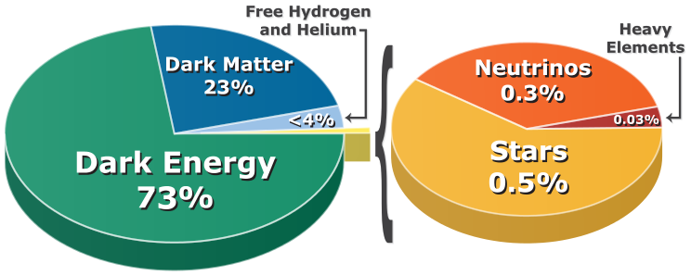
Dark matter
The evidence for dark matter is rich and complementary
Rotation curves of galaxies
Dynamics of galaxy clusters
Large scale clustering of matter in the universe
Cosmic background radiation (CBR) from the last scattering surface
We call it “dark” because it cannot be baryonic
CBR measures both baryonic and dark components
Big Bang Nucleosynthesis abundances strongly constrain baryonic density
What we know about dark matter
How much there is
It is largely “cold” in terms of its thermal motion
It is largely or entirely non-interactive
It is neutral and non-magnetic
What we sort of know about for dark matter
The process of its gravitational evolution
Its dynamical, gravitational interaction with baryons
There are many attractive particle candidates beyond the Standard Model

Slide 5
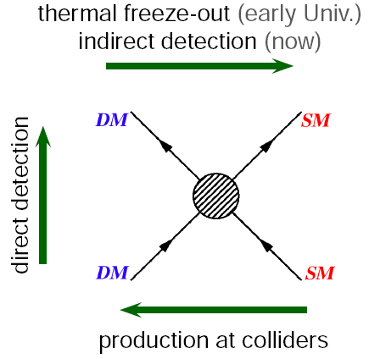
Probes of dark matter
The full diversity of Astrophysics probes of dark matter are buried here!
Arrows show
time direction
“SM” = Standard Model particles, baryonic matter
Figure credit: http://www.mpi-hd.mpg.de

Slide 6
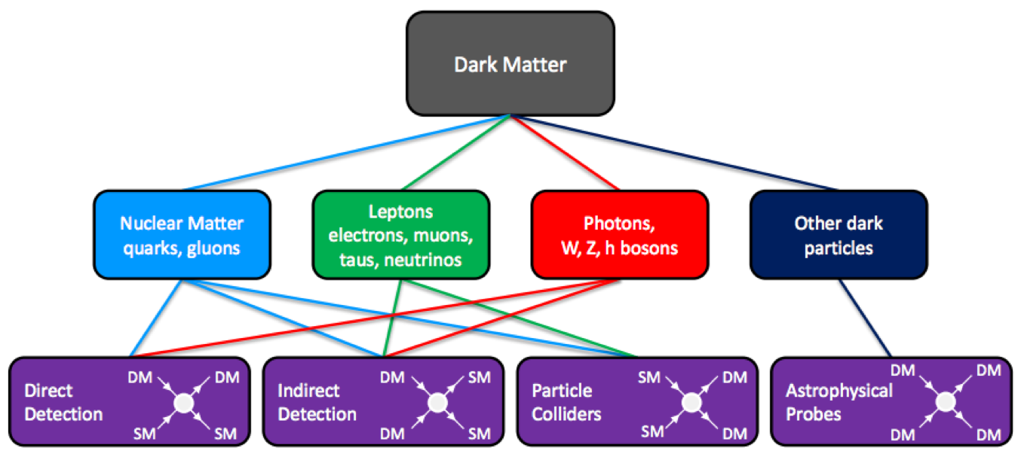
Probes of dark matter (beyond gravity)

Slide 7
Astrophysical probes of dark matter

Slide 8
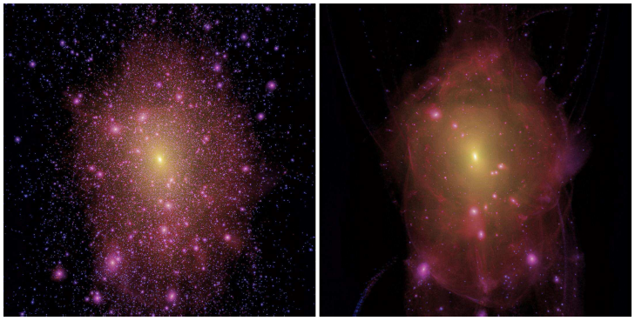
The nature of dark matter “matters”
Cold, non-interacting dark matter
Warm, non-interacting dark matter
Lovell+2012, MNRAS, 420, 2318
“Warm” = 2keV particles
Density-squared maps. M200~1.8E12Msun at z=0

Slide 9
A major personal motivation:
To meaningfully quantify the dark matter particle properties sensitivity of the dark-matter focused OMEGA Explorer proposal, being submitted this year.
See me for details!

Slide 10
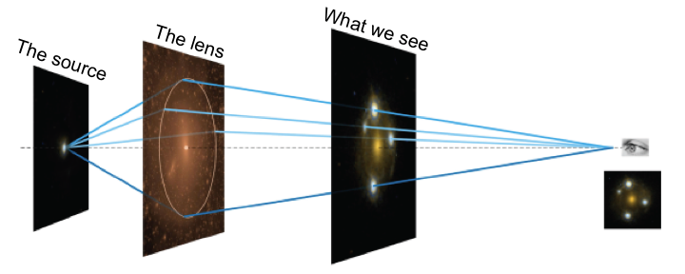

Slide 11
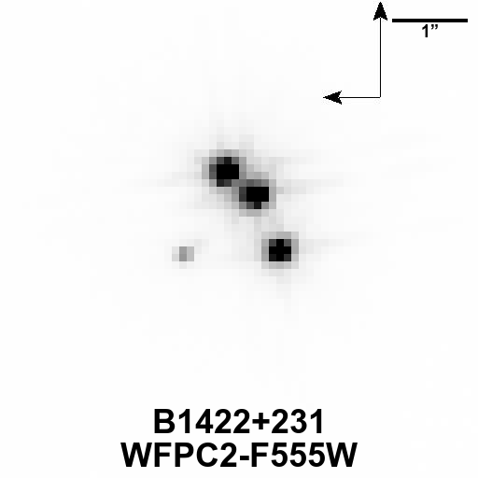
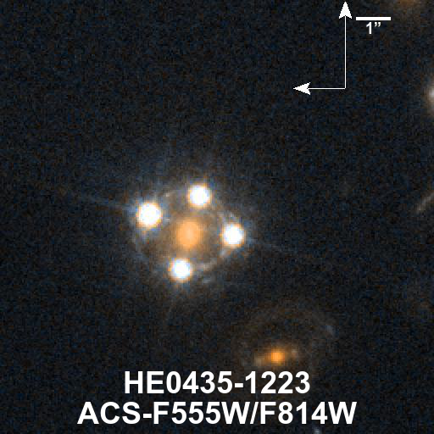
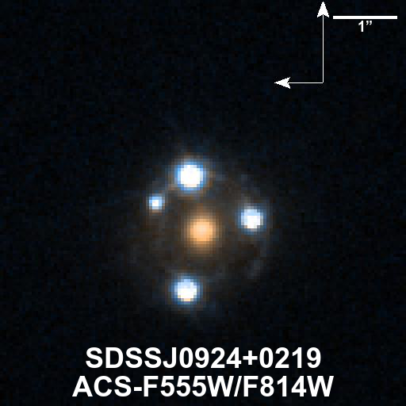
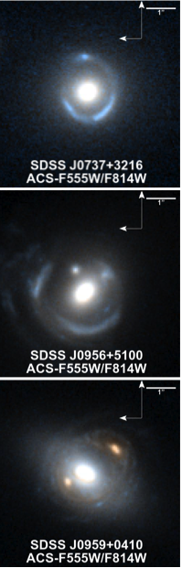
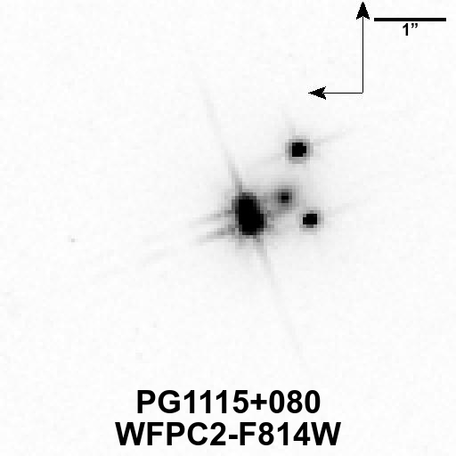
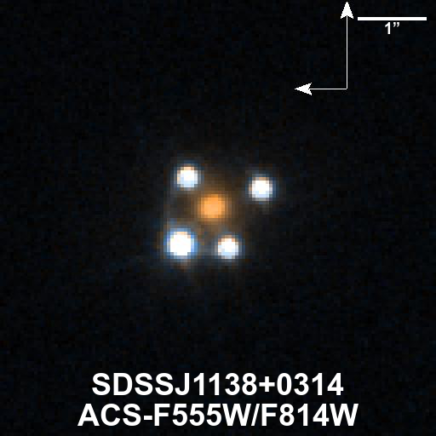
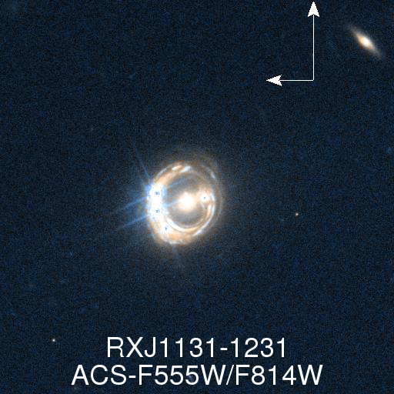
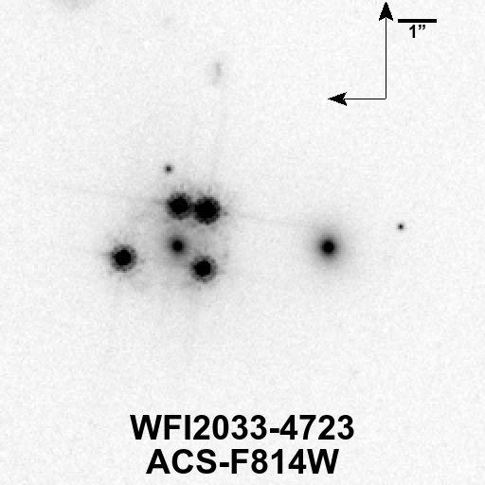
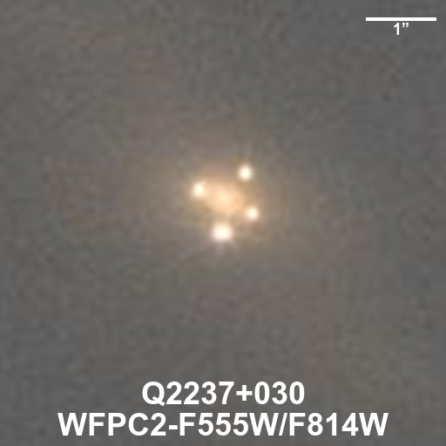
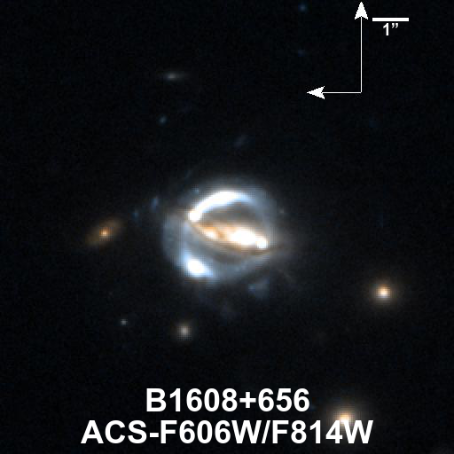

Slide 12
Steps to dark matter properties…

Slide 13
This Session’s Focus
Discuss a path to systematizing how the diversity of astronomical observations constrain different aspects of dark matter properties as they are expressed on astronomical scales.
Discuss how these expressed dark matter properties can be connected to physical properties of dark matter candidates or classes, towards defining metrics or figures of merit that are useful for astronomers, and meaningful for particle physicists.

Slide 14
Let us begin!
Resources
Data/talk/resource repository:
https://github.com/lmoustakas/specialdark
Google doc for notes, recording questions, etc:
http://tinyurl.com/AASspecialdark
Associated Poster session #337, check it out!
Logistics
All talks will be given in sequence, followed by a long discussion session
All talks are 8+2 minutes
Clarifying questions and comments welcome with each talk, save up the big and fun questions for the discussion at the end!

